Slide 1
Visualizing Multivariate Data
Visualizing Three Dimensions and Four Dimensions of Data using OpenGL
Under the guidance of
Mr. Narinder Pal Singh

Slide 2
INTRODUCTION
We have built a Mutivariate Data Visualization Tool using C++ and OpenGL.
This Tool can be used to easily represent large amounts of Data in a MultiDimensional Space.

Slide 3
TABLE OF CONTENTS
01
02
03
Reading Raw Data from a CSV File
Data Normalization
Data Representation in Four Dimensions
Data extractions from a CSV file in C++
Adjusting larger data values , so they can be represented accordingly
MultiDimensional Visual representation of data using OpenGL

Slide 4
Reading a Raw Data from a CSV File
A CSV file is a form of plain text document which uses a particular format to organize tabular information. We have used simple C++ Data Management to read the CSV file.
The data read acts as input for the Visualization Tool

Slide 5
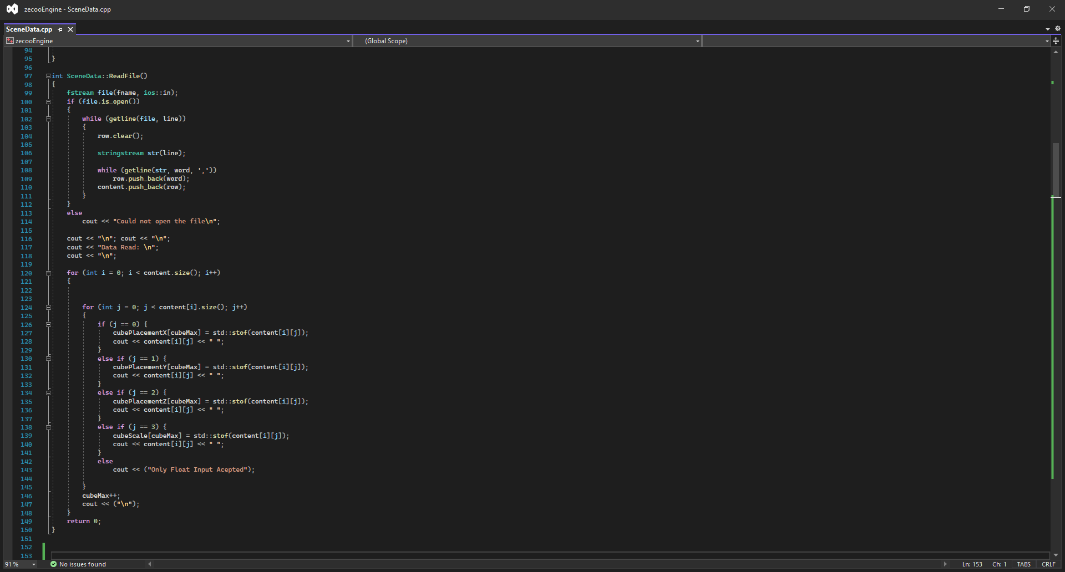
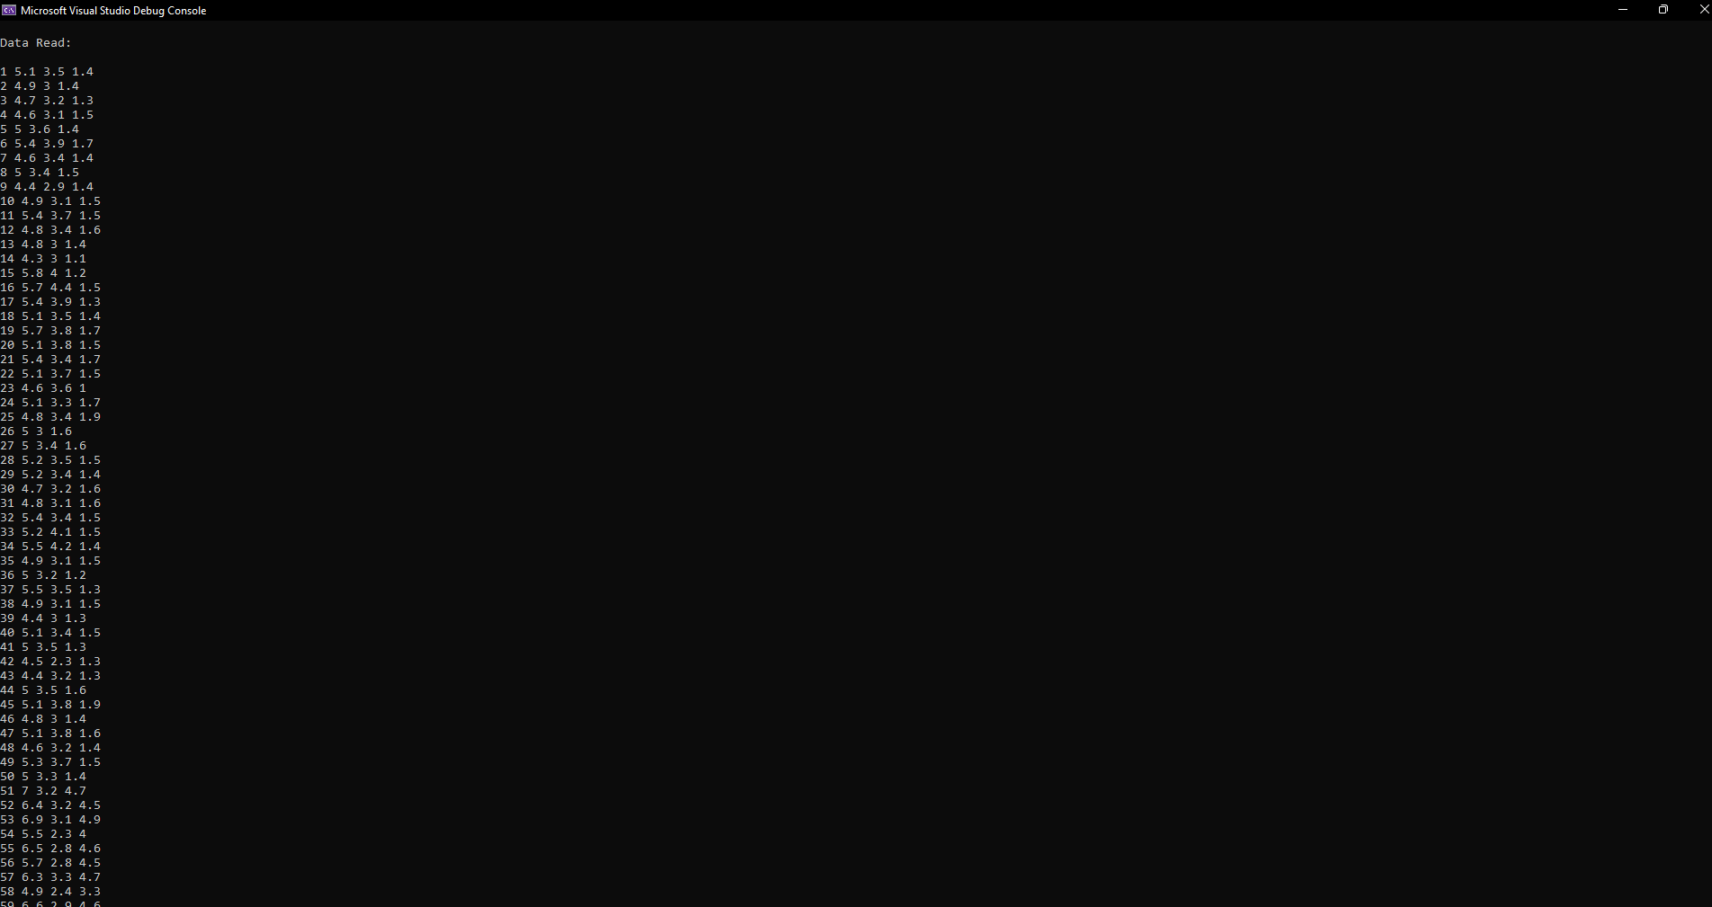

Slide 6
Data Normalization
Data Normalization is essentially a type of process where data is reorganized in such a way so that users can properly utilize that data for further queries and analysis.
There are a plenty of methods by which data can be normalized and a value manipulation method has been implemented in the shown mechanism.

Slide 7
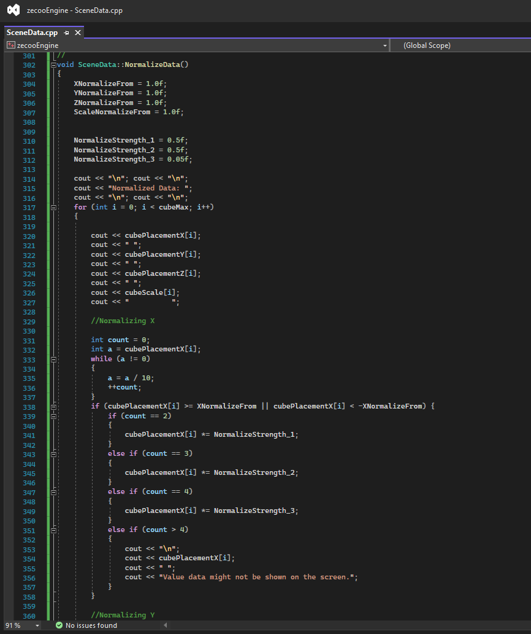
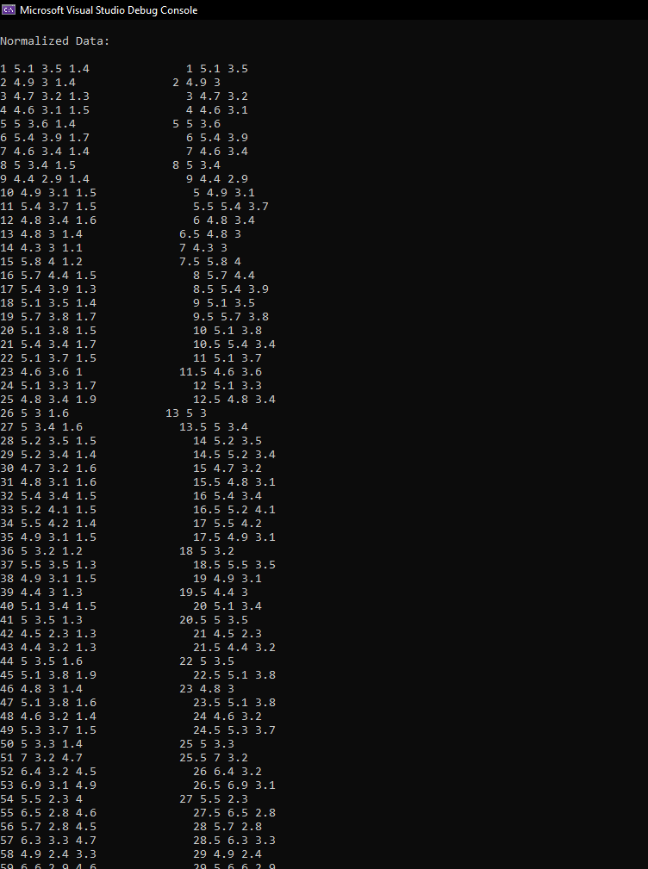

Slide 8
Data Representation in Four Dimension
Data visualization is an interdisciplinary field that deals with the graphic representation of data. It is a particularly efficient way of communicating when the data is numerous.
The tool normalizes the data and provides a Visualization Representation of Data.

Slide 9
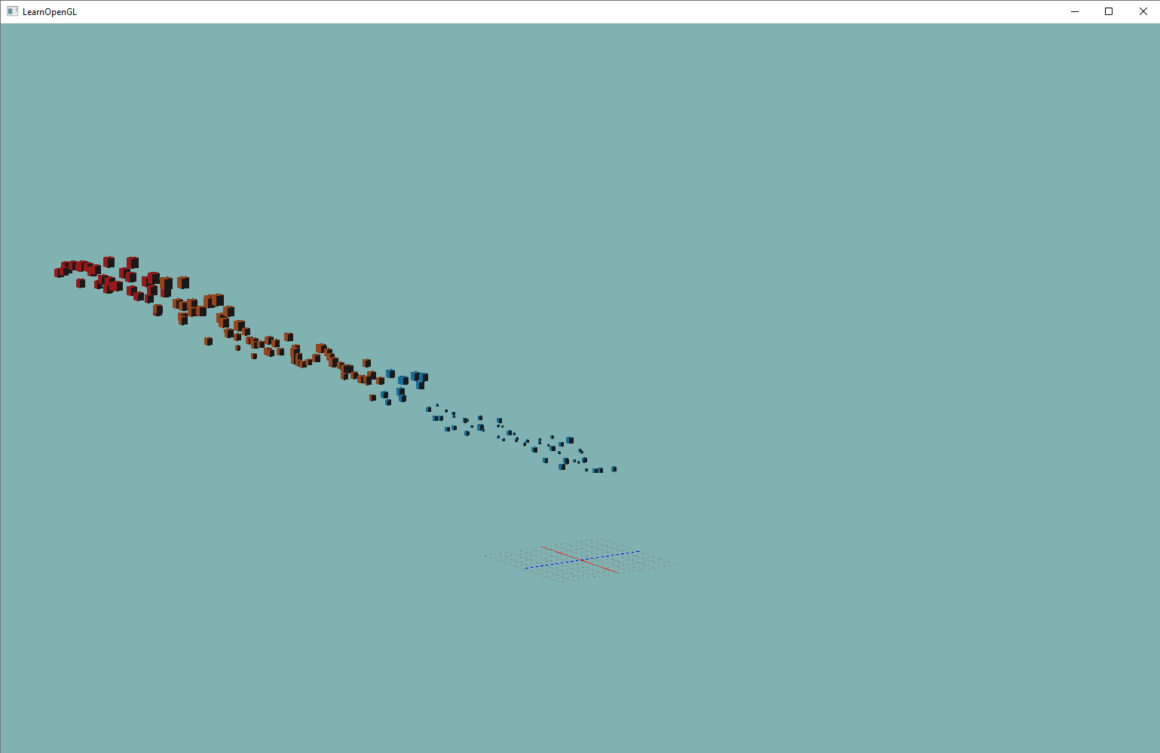

Slide 10


THE TEAM
RIDHAM SAINI
DAVESH MEHTA
1910991376
1910991367

Slide 11
THANK YOU

